Slide 1
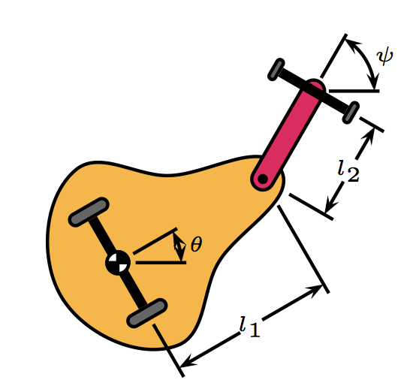


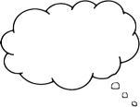
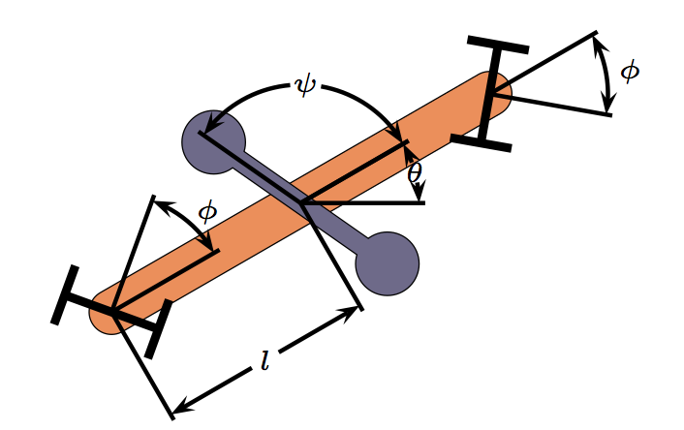

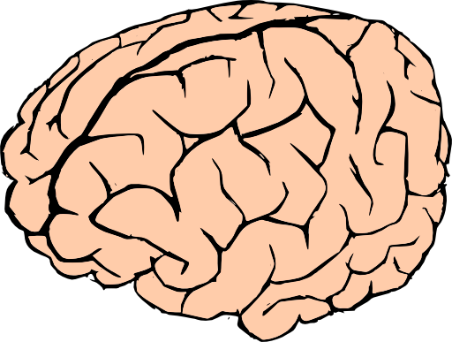





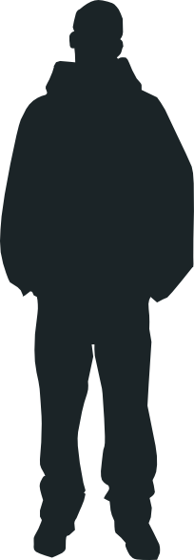


20 Years of Vehicles at CDS
in twenty-five minutes and zero formulas
Andrea Censi (’12)
LIDS
?

Slide 2
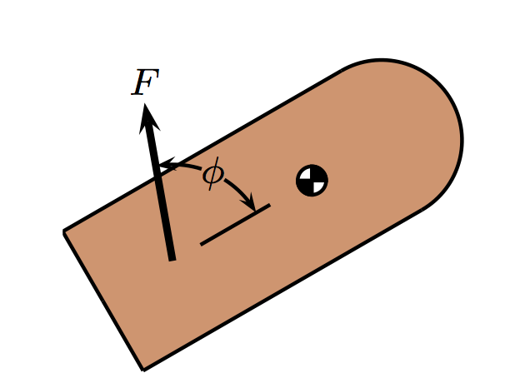
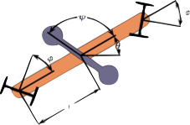
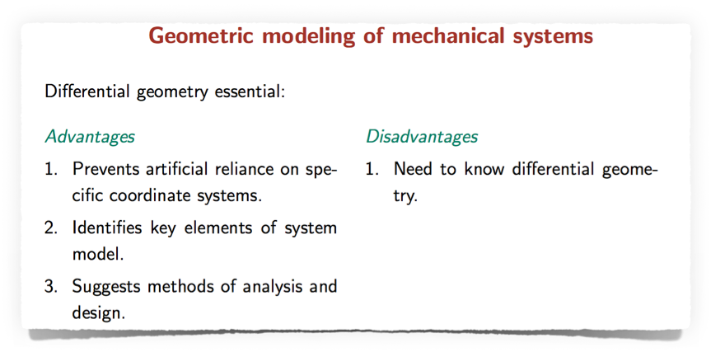
Geometric
Control
of Mechanical
Systems
Bullo, Lewis

Slide 3
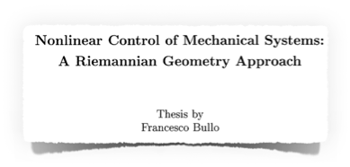
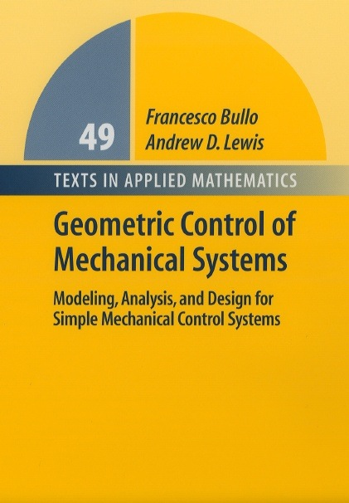
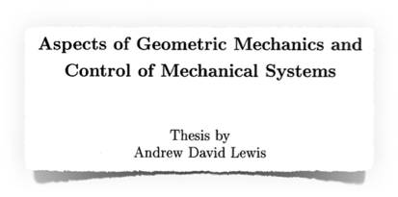
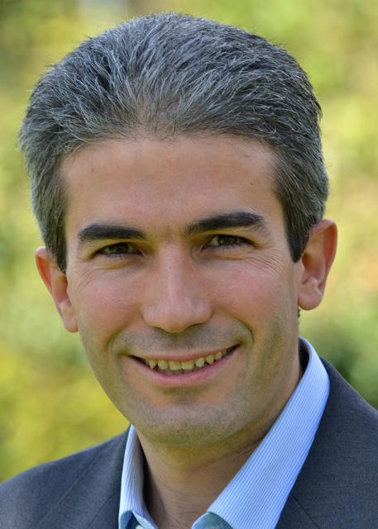
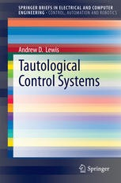
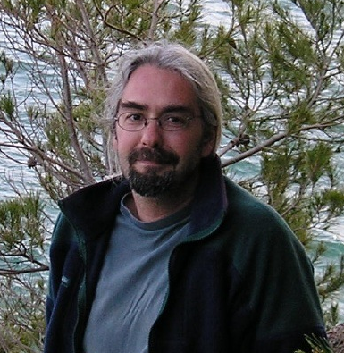
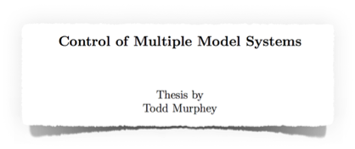
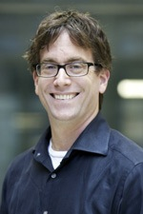
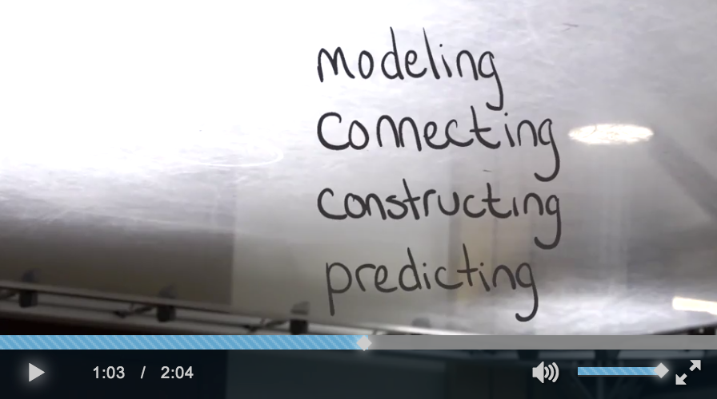
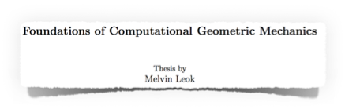
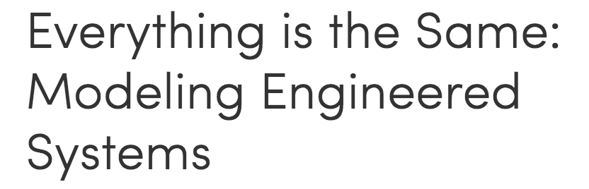
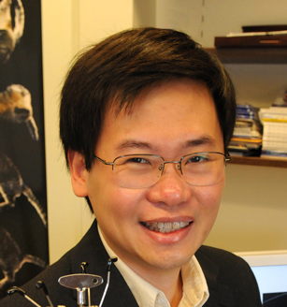

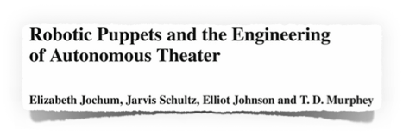
Geometric
Control
of Mechanical
Systems
1999
now: UCSB
1995, AM
now: Queens University Kingston (CA)
2002
now: Northwestern
2004
now: UCSD

Slide 4
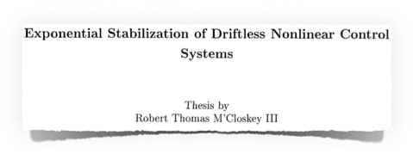
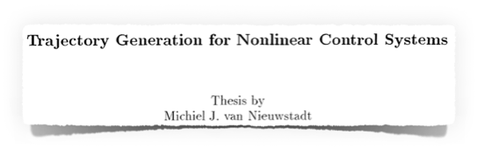
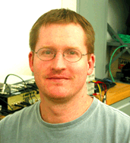
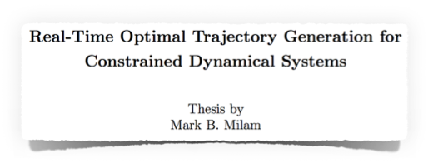
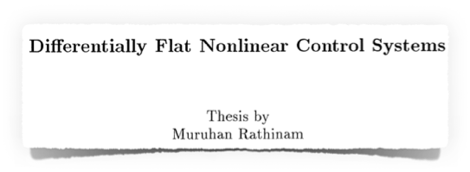
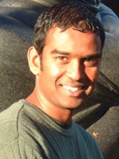
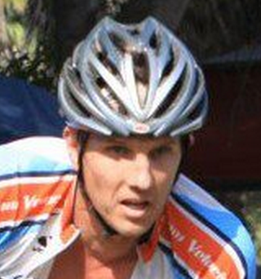
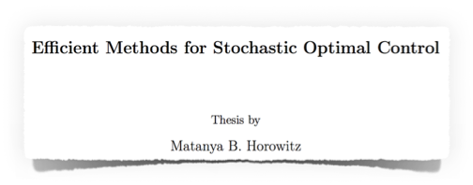
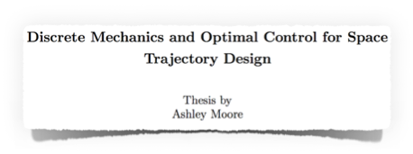
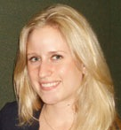
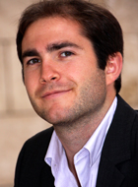
Trajectory Generation
and Optimal Control
1995, ME
1996, ME
now: Ford
now: UCLA
2003
1997, AM
now: Northrop Grumman
now: UMBC
2014
2011
now: The Aerospace Corporation
now: Cognitive Robotics (startup)
Team Leader Diesel Controls
University of Maryland, Baltimore County.

Slide 5
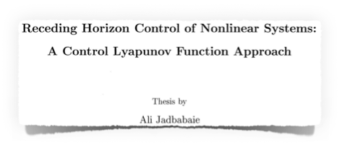
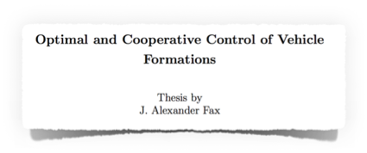
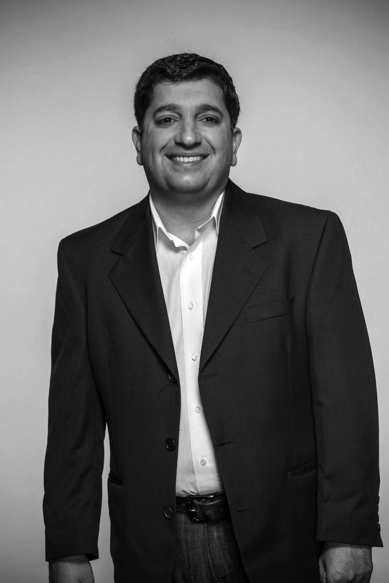
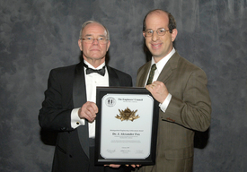
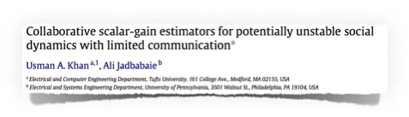
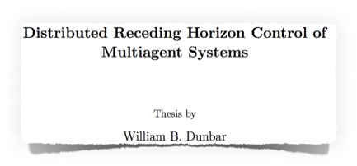
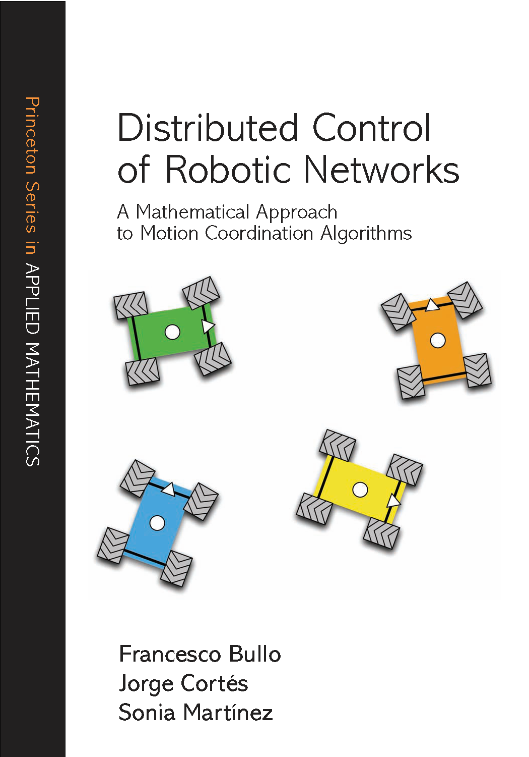
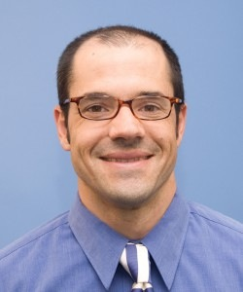
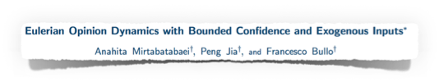
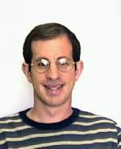
Control
of Mechanical Systems
Distributed
Control
Dynamics and Control
of Information Flows
2001
2002
now: UPenn
now: Northrop Grumman
2004
now: UCSC
Dr. Alex Fax (right) from Northrop Grumman's Navigation Systems Division received a Distinguished Engineering Achievement Award from Dr. Charles Volk for advancement of novel navigation solutions for non-traditional applications operating in challenging environments.
Northrop Grumman

Slide 6
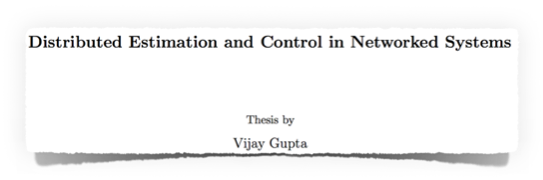
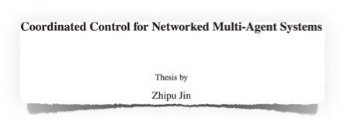
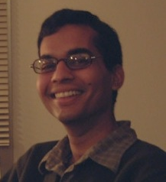
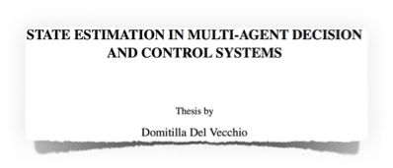
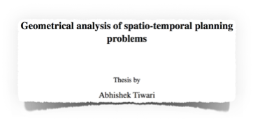
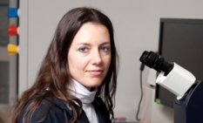
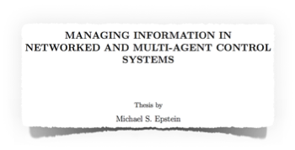
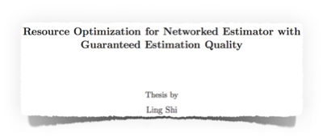


Control
of Mechanical Systems
Distributed
Control
Dynamics and Control
of Information Flows
with Hassibi
2007, EE
2007, EE
now: Shape Security
now: U. Notre Dame
2007, EE
now: Silvus
Technologies
2007
now: MIT
2008, ME
2009
now: McKinsey
now: HKUST

Slide 7






(1997, EE)
now: ETHZ
2006
2014

Slide 8









Perception
as a Dynamic Process
Control
of Perception Process
(SLAM)
2003
1996
now: GATECH
now: UCLA
2013
2013
2007, ME
now: NPS

Slide 9
Legend
1994-2000
2000-2008
2009-2014
CDS degree (non CDS)
Formal methods
Autonomy
Stefano Soatto
(Tim Chung)
Inference
(Michael Epstein)
Patricio Vela
Vijay Gupta
Ling Shi
Abhishek Tiwari
Networks
(Zhipu Jin)
Francesco Bullo
Bio-inspired
control
D. Del Vecchio
Alex Fax
(Andrew Lewis)
Control
Mark Milan
Ali Jadbabaie
Todd Murphey
(M. van Nieuwstadt)
Muruhan Rathinam
William Dunbar
(Raff. D’Andrea)
Melvin Leok
Ashley Moore
Matanya Horovitz
Biology
Robert M’Closkey
(Scott Kelly)

Slide 10




Neuroethology
and Biomechanics
?
Michael Dickinson
Floris Van Bruegel

Slide 11



Neuroethology
and Biomechanics
?
?
stimulus
brain
decisions
Michael Dickinson
tracked trajectories
Andrew Straw

Slide 12








Typical problem: delayed gratification
Neuroethology
and Biomechanics
?
tracking cameras
2011, BE
now: Harvard
Winner, 2008 “Art in Science” competition
2014
now: UW
Fuller SB, Straw AD, Peek MY, Murray RM
and Dickinson MH, PNAS 2014

Slide 13











Bio-inspired Control
1998, ME
now: UNCC
2006, ME
now: UMD

Slide 14






Bio-inspired Control
2012
2014, EE
now: UPenn
Floris Van Bruegel
Sawyer Fuller

Slide 15
Legend
1994-2000
2000-2008
2009-2014
CDS degree (non CDS)
Formal methods
Stefano Soatto
Autonomy
(Tim Chung)
Inference
(Michael Epstein)
Patricio Vela
Vijay Gupta
Ling Shi
Abhishek Tiwari
Networks
(Zhipu Jin)
Francesco Bullo
Bio-inspired
D. Del Vecchio
Alex Fax
Melvin Flores
(Andrew Lewis)
(Sean Humbert)
Control
Mark Milan
Ali Jadbabaie
Todd Murphey
(Shuo Han)
(M. van Nieuwstadt)
Andrew Lamperski
Muruhan Rathinam
(Sawyer Fuller)
William Dunbar
(Raff. D’Andrea)
Melvin Leok
Floris Van Bruegel
Ashley Moore
Matanya Horovitz
Neuroethology
Robert M’Closkey
(Scott Kelly)

Slide 16











Autonomous
Vehicles
2006, ME
now: Aerovironment
2008
2008, ME
now: JPL
now: JPL

Slide 17






Social
Robots
2012
now: Matrix Research
Robot
Learning
y
u
2012
now: MIT

Slide 18











unsafe
Formal
Methods
goal
unsafe
2010, ME
now: Ministry of Science, Thailand
2009, ME
now: NASA JSC (Houston)
2014
now: Nutonomy (startup, Boston)
2013, ME
now: UMD
2014
now: Humin (startup, SF)

Slide 19
Legend
￼
1994-2000
2000-2008
2009-2014
CDS degree (non CDS)
complex
Formal methods
Eric Wolff
(Nok)
(Mumu Xu)
Rangoli Sharan
(Julia Braman)
(John Carson)
Stefano Soatto
(Tim Chung)
Autonomy
Pete Trautman
Inference
(Michael Epstein)
Patricio Vela
Vijay Gupta
Ling Shi
Andrea Censi
Abhishek Tiwari
(Lars Cremean)
Networks
(Zhipu Jin)
Francesco Bullo
Bio-inspired Control
D. Del Vecchio
Alex Fax
Melvin Flores
(Andrew Lewis)
(Sean Humbert)
Control
Mark Milan
Ali Jadbabaie
Todd Murphey
(Shuo Han)
(M. van Nieuwstadt)
Andrew Lamperski
Muruhan Rathinam
(Sawyer Fuller)
William Dunbar
simple
(not “easy”!)
(Raff. D’Andrea)
Melvin Leok
Floris Van Bruegel
Ashley Moore
Matanya Horovitz
Neuroethology
Robert M’Closkey
(Scott Kelly)
theory
data / algorithms

Slide 20
Legend
1994-2000
2000-2008
2009-2014
CDS degree (non CDS)
faculty appointment
Eric Wolff
(Nok)
(Mumu Xu)
Rangoli Sharan
(Julia Braman)
(John Carson)
Stefano Soatto
(Tim Chung)
Pete Trautman
(Michael Epstein)
Patricio Vela
Vijay Gupta
Ling Shi
Andrea Censi
Abhishek Tiwari
(Lars Cremean)
(Zhipu Jin)
Francesco Bullo
D. Del Vecchio
Alex Fax
Melvin Flores
(Andrew Lewis)
(Sean Humbert)
Mark Milan
Ali Jadbabaie
Todd Murphey
(Shuo Han)
(M. van Nieuwstadt)
Andrew Lamperski
Muruhan Rathinam
(Sawyer Fuller)
William Dunbar
(Raff. D’Andrea)
Melvin Leok
Floris Van Bruegel
Ashley Moore
Matanya Horovitz
Robert M’Closkey
(Scott Kelly)

Slide 21


Slide 22


CDS: The Power of Theory

